Slide 1
"Digital Media Primer" Yue-Ling Wong,
Copyright (c)2013 by Pearson Education, Inc. All rights reserved.

Slide 2
Chapter 3
Capturing and Editing Digital Images
Part 6
Output Images for Print

Slide 3
In this lecture, you will learn:
how to estimate the print size based on the print resolution and the pixel dimensions of the image
how to estimate the print resolution based on the print size and the pixel dimensions of the image
how to estimate the pixel dimensions of the image based on the print size and the print resolution

Slide 4
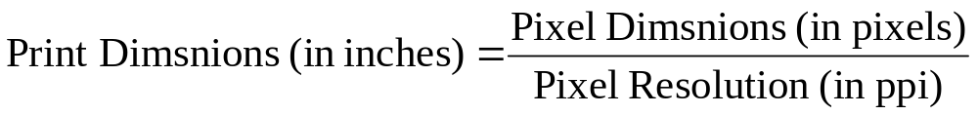
Print Size of an Image
Both the pixel dimensions of an image and the image resolution (ppi) affect the image’s print size.

Slide 5
Print Size of an Image
Both the pixel dimensions of an image and the image resolution (ppi) affect the image’s print size.
What this means that you can't determine the print size if you:
only know the pixel dimensions of an image without the print resolution (ppi)
only know the print resolution (ppi) without the pixel dimensions of an image

Slide 6
To better understand the equation, let's look at 3 scenarios and plug in some numbers.

Slide 7
Scenario 1:
Maintaining the Print Dimensions
To make an 8" x 4.5" print
Print Resolution (ppi) | Required Pixel Dimensions
100 ppi | width = 8" × 100 ppi = 800 pixels height = 4.5" × 100 ppi = 450 pixels
200 ppi | width = 8" × 200 ppi = 1600 pixels height = 4.5" × 200 ppi = 900 pixels
300 ppi | width = 8" × 300 ppi = 2400 pixels height = 4.5" × 300 ppi = 1350 pixels
With a fixed print size, you need larger pixel dimensions with a higher print ppi.

Slide 8
Scenario 2:
Maintaining the Pixel Dimensions
For an image of 1600 x 900 pixels
Print Resolution (ppi) | Resulted Print Size
100 ppi | width = 1600 pixels / 100 ppi = 16" height = 900 pixels / 100 ppi = 9"
200 ppi | width = 1600 pixels / 200 ppi = 8" height = 900 pixels / 200 ppi = 4.5"
300 ppi | width = 1600 pixels / 300 ppi = 5.3" height = 900 pixels / 300 ppi = 3"
With fixed pixel dimensions, you get a smaller print with a higher print ppi.

Slide 9
Scenario 3:
Maintaining the Print PPI
Suppose the print resolution is kept at 300 ppi
Print Size | Required Pixel Dimensions
5.3" × 3" | width = 5.3" × 300 ppi = 1600 pixels height = 3" × 300 ppi = 900 pixels
8" × 4.5" | width = 8" × 300 ppi = 2400 pixels height = 4.5" × 300 ppi = 1350 pixels
16" × 9" | width = 16" × 300 ppi = 4800 pixels height = 9" × 300 ppi = 2700 pixels
With a fixed print ppi, you need larger pixel dimensions for a larger print.

Slide 10
So, how are these scenarios translated into the settings used in an image-editing program?

Slide 11
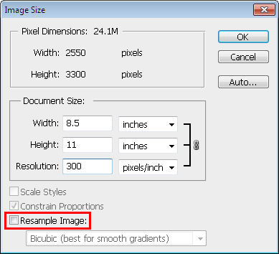
Adjust Output Resolution or Print Size in Photoshop:
Image > Image Size...
Scenario 2: Fixed pixel dimensions
You cannot change the pixel dimensions

Slide 12
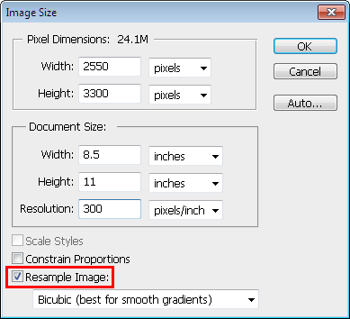
Adjust Output Resolution or Print Size in Photoshop:
Image > Image Size...
Scenario 1: Fixed Print Size
If you change the Resolution, the Pixel Dimensions will be updated automatically while keeping the print size fixed.

Slide 13
Adjust Output Resolution or Print Size in Photoshop:
Image > Image Size...
Scenario 3: Fixed Print Resolution (PPI)
If you change the Pixel Dimensions or Document Size, the other will be updated automatically while keeping the Resolution fixed.

Slide 14
Resample Image
With the Resample Image option on, the pixel dimensions can be varied.
Scaling the pixel dimensions of an image is referred to as resampling because the number of samples (pixels) is changed.

Slide 15
Effect of Resampling Image on Image Quality
Scaling an image usually deteriorates the image quality somewhat.
Scale down: You are removing pixels, i.e., the image will lose some details.
Scale up: Interpolation will be perform to fill in extra pixels. The resulted image will appear blurry.

Slide 16
Print Resolution PPI vs.
Printer Resolution DPI
Print Resolution PPI ≠ Printer Resolution DPI

Slide 17
Printer Resolution DPI
Number of ink dots per inch
Color inkjet printers produce a microscopic spray of ink which appears to be very tiny dots of ink.
These ink dots of different colors--but a limited number of colors--produce the required color by optical mixing.
The color of a single pixel of an image is represented by a group of printer dots.

Slide 18
Print PPI vs. Printer DPI
 | Increasing Print PPI | Increasing Printer DPI
Effect on print size | Depending on the scenario, the print size may decrease or maintain the same. | No
Effect on image quality | No | The color appears smoother on the print. However, higher dpi uses more ink and requires longer time to complete the print job

Slide 19

An interactive demonstration on optical color mixing
Also see the interactive tutorial:
OPTICAL COLOR MIXING IN POINTILLISM,
DITHERING, AND INKJET PRINTING

Slide 20
Review Questions
Note to instructor:
Depending on your preference, you may want to go over the review questions at the end of this lecture as an instant review or at the beginning of next lecture to refresh students' memory of this lecture.

Slide 21
Review Question
True/False: When a digital image is printed, each image pixel is represented by one printer ink dot.
Notes:
False

Slide 22
Review Question
Resampling an image is often referred to as ______ .
A. rotating
B. scaling
C. translating
D. repositioning
Notes:
B

Slide 23
Review Question
True/False: Resampling an image will have negative impact on the image quality.
Notes:
True

Slide 24
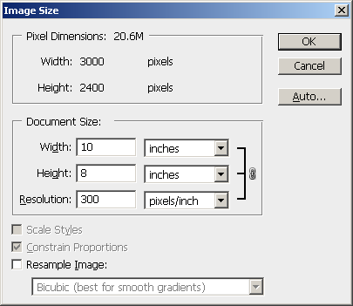
Review Question
The pixel dimensions of the image are ___ × ___.
Notes:
3000 x 2000 pixels

Slide 25
Review Question
The physical size of the image, if it is printed out is ___ × ___.
Notes:
10" x 8"

Slide 26
Review Question
The printing resolution of the image is ___.
Notes:
300 ppi

Slide 27
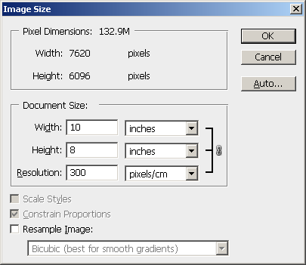
Review Question
The image should have the pixel dimensions 3000 × 2000 pixels. Identify the incorrect setting that causes such a discrepancy in pixel dimensions.
Notes:
The unit in the Resolution is set to pixels/cm; it should be pixels/inch.

Slide 28
Review Question
For the following questions, predict the new values in the Image Size window.

Slide 29
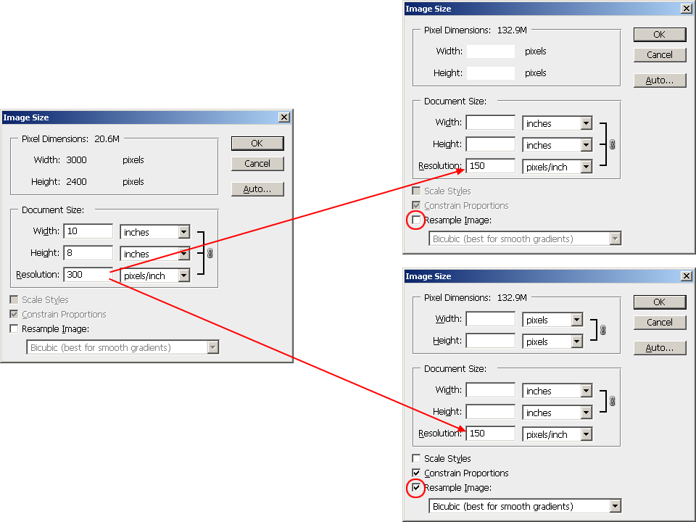

Slide 30
Answers
3000
2400
20
16
1500
1200
10
8

Slide 31
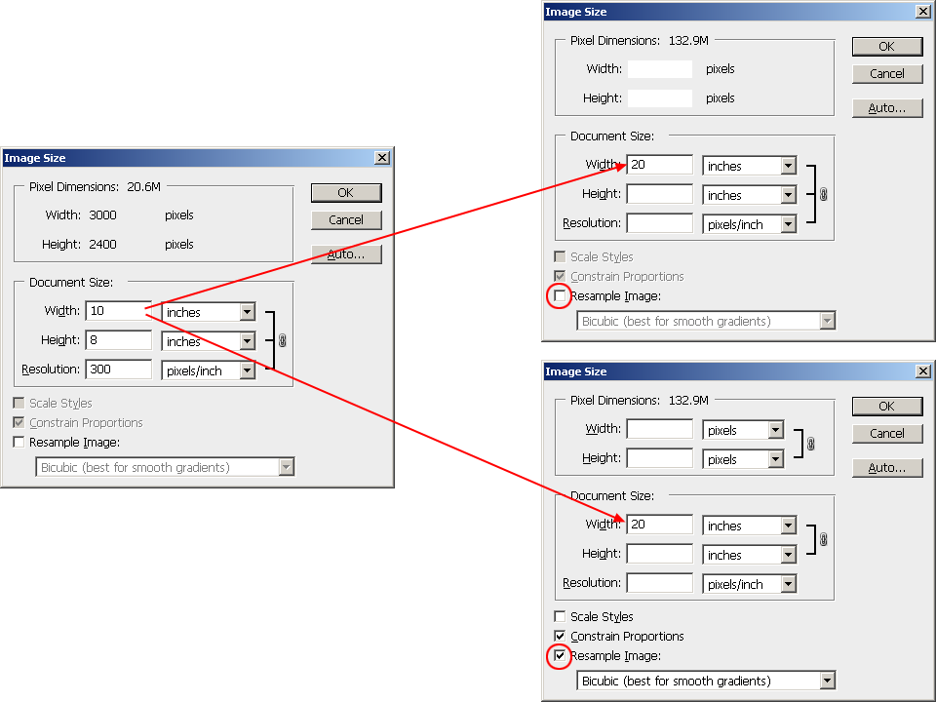

Slide 32
Answers
3000
2400
16
150
6000
2400
16
300

Slide 33
Review Question
Suppose you have created an image (with size information shown in the next slide) and you want to print it on a 10" × 8" paper with at least a half-inch margin all around. Fill in the correct image settings that can accomplish this task with the maximum printed area for the image without affecting the image quality.

Slide 34
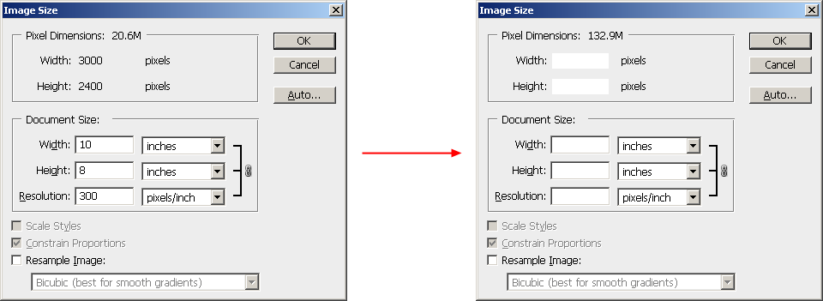

Slide 35
Answers
3000
2400
8.75
7
343
unchecked

